Slide 1
System Software
Course Code: 17ECSC302
Credits: 3
Semester: V
School of Computer Science & Engineering

Slide 2
A Language-Processing System
A language processing system houses various system software’s like pre-processor, compiler, Assembler, Linker, Loader etc in converting a source program to target machine code.

Slide 3
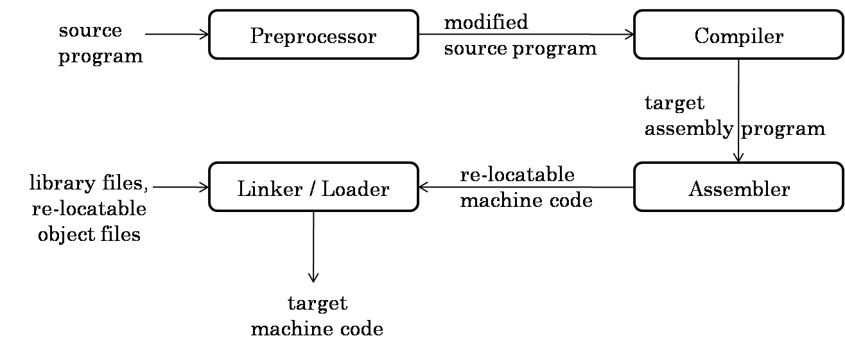
Language-Processing System

Slide 4
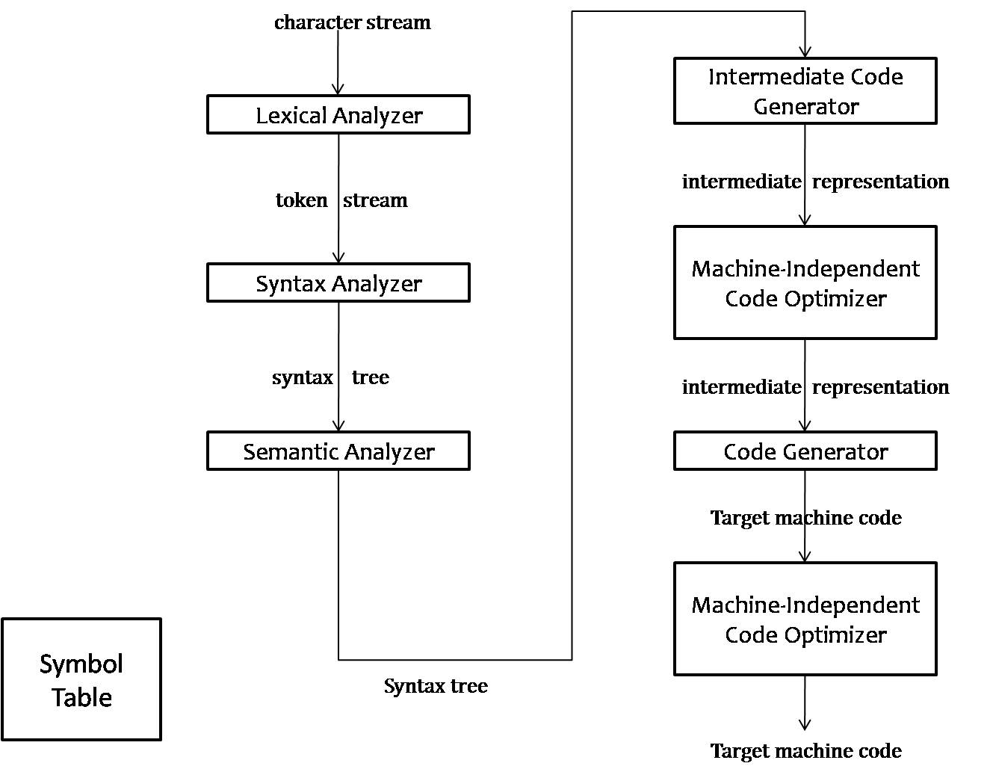
Phases of a Compiler

Slide 5
Chapter 01
Introduction to a Machine Architecture

Slide 6
Outline of Chapter 01
System Software and Machine Architecture
Simplified Instructional Computer (SIC)
SIC/XE Machine Architecture
SIC and SIC/XE Programming Examples

Slide 7
Introduction
Practical computer systems divide software into two major classes:
Application Software
System Software
System Software:
Definition
  System software consists of a variety of programs that support the operation of a computer .
  To study “behind the scene”

Slide 8
System Software vs. Machine Architecture
One characteristic in which most system software differ from is machine dependency
  e.g. assembler translate mnemonic instructions into machine code
  e.g. compilers must generate machine language code
  e.g. operating systems are directly concerned with the management of nearly all of the resources of a computing system
There are some aspects of system software that do not directly depend upon the type of computing system
  e.g. general design and logic of an assembler
  e.g. code optimization techniques

Slide 9
Simplified Instructional Computer (SIC)
SIC is a hypothetical computer that includes the hardware features most often found on real machines
Two versions of SIC
  standard model
  extension version (XE version)

Slide 10
SIC Machine Architecture
Features
    Memory
    Register
    Data Format
    Instruction Format
    Addressing Mode
    Input/output
    Instruction Set

Slide 11
SIC Machine Architecture
Memory
  8-bit bytes
  3 consecutive bytes form a word (24 bits)
  All addresses in SIC are byte addresses
  2¹⁵ bytes =32768 bytes in the computer memory

Slide 12
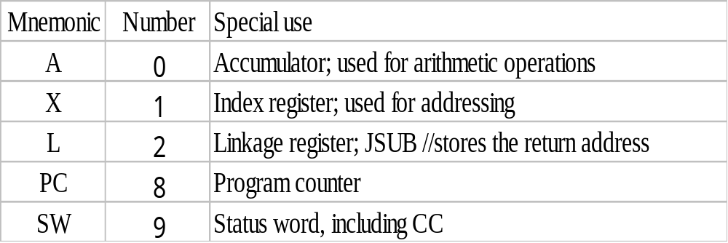
SIC Machine Architecture
Registers
There are 5 registers all of 24bits in length

Slide 13
SIC Machine Architecture
Data Formats
  Integers are stored as 24-bit binary numbers
  2’s complement representation is used for negative values
  8 bit ASCII code for characters
  No floating-point hardware

Slide 14
Instruction Formats
In each instruction programmer has to specify 3 things:
  Operation to be performed
  Address of source data
  Address of destination of result

Slide 15
Addressing Modes
The term addressing modes refers to the way in which the operand of an instruction is specified. Information contained in the instruction code is the value of the operand or the address of the result/operand.
The method by which the address of source of data or the address of destination of result is specified in the instruction is called addressing mode.

Slide 16
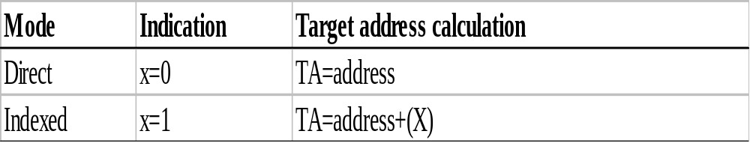
SIC Machine Architecture
Instruction Formats
All instructions are of 24 bit format
Addressing Modes
opcode (8)
x
address (15)

Slide 17
SIC Machine Architecture
Instruction Set
  Data transfer group
  Arithmetic group
  Logical group
  Branch group
  Machine group

Slide 18
SIC Machine Architecture
Data transfer Instructions
  LDA-load data into accumulator
  LDX- load data into index register
  LDL-load data into linkage register
  LDCH-load char into accumulator
  STA-store the contents of A into the memory
  STX-store the contents of X into the memory
  STL-store the contents of L into the memory
  STSW-store the contents of SW into the memory

Slide 19
SIC Machine Architecture
Arithmetic group of Instructions
  ADD
  SUB
  MUL
  DIV
  All arithmetic operations involve register A and a word in memory, with the result being left in the register

Slide 20
SIC Machine Architecture
Logical group of Instructions
  AND
  OR
Both involve register A and a word in memory, with the result being left in the register. Condition flag is not affected.
  COMP
Compares the value in register A(<,>,=) with a word in memory, this instruction sets a condition code CC to indicate the result.

Slide 21
SIC Machine Architecture
Branch group of Instructions
  Conditional jump instructions
  Unconditional jump instructions
  Subroutine linkage

Slide 22
SIC Machine Architecture
Instruction Set
  Conditional jump instructions:
    JLT
    JEQ
    JGT
    these instructions test the setting of CC (<.=.>)and jump accordingly.

Slide 23
SIC Machine Architecture
Instruction Set
  Unconditional jump instructions:
  J
    This instruction without testing the setting of CC , jumps directly to assigned memory.

Slide 24
SIC Machine Architecture
  Subroutine linkage:
  JSUB
    JSUB jumps to the subroutine, placing the return address in register L
    ( L ← PC , PC ← subroutine address)
  RSUB
    RSUB returns by jumping to the address contained in register L
    ( PC ← L )

Slide 25
SIC Machine Architecture
Input and Output
  Input and output are performed by transferring 1 byte at a time to or from the rightmost 8 bits of register A.
  Test Device TD instruction tests whether the addressed device is ready to send or receive a byte of data.
  if CC=‘<‘ the device is ready to send or receive.
  if CC=‘=‘ the device is not ready to send or receive.

Slide 26
SIC Machine Architecture
Input and Output
  Read Data RD
    Data from the input device specified by the memory is read into A lower order byte.
  Write Data WD
    Data is sent to output device specified by the memory.

Slide 27
SIC Machine Architecture
Input and Output
  TIX
    Increments the content of X and compares its content with memory
    Depending on the result the conditional flags are updated
    if (X) < (m) then CC = ‘<‘
    if (X) = (m) then CC = ‘=‘
    if (X) > (m) then CC = ‘>‘

Slide 28
SIC/XE Machine Architecture
Memory
  Memory structure is same as that for SIC.
  2²⁰ bytes in the computer memory.
  This increase leads to a change in instruction format and addressing modes.

Slide 29
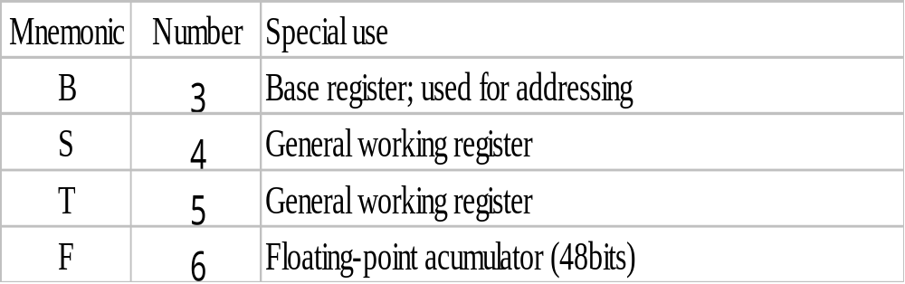
SIC/XE Machine Architecture
More Registers

Slide 30
SIC/XE Machine Architecture
Data Formats
  Same data format as that of SIC
  Floating-point data type of 48 bits
    frac: 0~1
    exp: 0~2047
    S(0=+ve , 1=-ve)
The absolute value of the number is frac*2^{(exp-1024)}
s
exponent (11)
fraction (36)

Slide 31
SIC/XE Machine Architecture
Instruction Formats
  The instruction format of SIC/XE is modified to suit the changes made in the hardware such as:
    Enhancing the number of address lines
    Increasing the number of registers
    Providing floating point accumulator

Slide 32
SIC/XE Machine Architecture
Instruction Formats
Formats 1 and 2 are instructions that do not reference memory at all
8
op
Format 1 (1 byte)
8 | 4 | 4
op | r1 | r2
Format 2 (2 bytes)
6 | 1 | 1 | 1 | 1 | 1 | 1 | 12
op | n | i | x | b | p | e | displacement
Format 3 (3 bytes)
6 | 1 | 1 | 1 | 1 | 1 | 1 | 20
op | n | i | x | b | p | e | address
Format 4 (4 bytes)

Slide 33
SIC/XE Machine Architecture
The Format 3 and Format 4 instructions have 6 flag bits:-
n – indirect addressing
I – immediate addressing
x – indexed addressing
b – base relative
p – PC relative
e – (0 – Format 3 1 – Format 4)

Slide 34
SIC/XE Machine Architecture
Addressing modes
  Base relative (n=1, i=1, b=1, p=0)
  Program-counter relative (n=1, i=1, b=0, p=1)
  Direct (n=1, i=1, b=0, p=0)
  Immediate (n=0, i=1, x=0)
  Indirect (n=1, i=0, x=0)
  Indexing (both n & i = 0 or 1, x=1)
  Extended (e=1)

Slide 35
SIC/XE Machine Architecture
Base Relative Addressing Mode (STCH BUF,X)
 | n | i | x | b | p | e
opcode | 1 | 1 |  | 1 | 0 |  | disp
n=1, i=1, b=1, p=0, TA=(B)+disp (0≤disp ≤4095)
PC Relative Addressing Mode (J Next)(-ve=2’s comp
 | n | i | x | b | p | e
opcode | 1 | 1 |  | 0 | 1 |  | disp
n=1, i=1, b=0, p=1, TA=(PC)+disp (-2048≤disp ≤2047)

Slide 36
SIC/XE Machine Architecture
Direct Addressing Mode
 | n | i | x | b | p | e
opcode | 1 | 1 |  | 0 | 0 |  | disp
n=1, i=1, b=0, p=0, TA=disp (0≤disp ≤4095)
 | n | i | x | b | p | e
opcode | 1 | 1 | 1 | 0 | 0 |  | disp
n=1, i=1, b=0, p=0, TA=(X)+disp (with index addressing mode)

Slide 37
SIC/XE Machine Architecture
Immediate Addressing Mode (ADD #30)
 | n | i | x | b | p | e
opcode | 0 | 1 | 0 |  |  |  | disp
n=0, i=1, x=0, operand=disp
Indirect Addressing Mode (ADD @2000)
 | n | i | x | b | p | e
opcode | 1 | 0 | 0 |  |  |  | disp
n=1, i=0, x=0, TA=(disp)

Slide 38
SIC/XE Machine Architecture
Simple Addressing Mode (LDA NUM)
 | n | i | x | b | p | e
opcode | 0 | 0 |  |  |  |  | disp
i=0, n=0, TA=bpe+disp (SIC standard)
 | n | i | x | b | p | e
opcode | 1 | 1 |  |  |  |  | disp
i=1, n=1, TA=disp (SIC/XE standard)

Slide 39
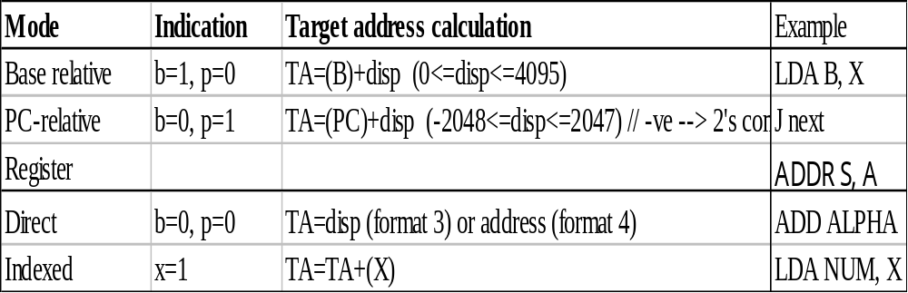
SIC/XE Machine Architecture
Addressing Modes

Slide 40
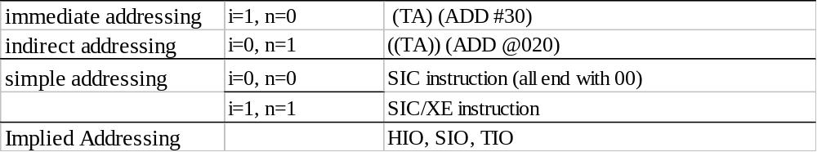
SIC/XE Machine Architecture
Addressing Modes
  Note: Indexing cannot be used with immediate or indirect addressing modes

Slide 41
SIC/XE Machine Architecture
Data transfer Instructions
  LDB(68)-load data into BASE register
  LDS(6E)- load data into S register
  LPS(D0)-load processor status
  LDT(04)-load data into T register
  LDF(70)-load data into F register
  STB-store the contents of B into the memory
  STS-store the contents of S into the memory
  STL(14)-store the contents of L into the memory
  STSW(E8)-store the contents of SW into the memory

Slide 42
SIC/XE Machine Architecture
Instruction Set
  new registers: LDB,LDL,LDS, STB, etc.
  floating-point arithmetic: ADDF, SUBF, MULF, DIVF
  register move:data transfer from 1 reg to another reg RMO S,A (S→A)
  register-register arithmetic: ADDR, SUBR, MULR, DIVR
  Logical :
    COMPR A,S
    CLEAR X
    SHIFTL T,n
    SHIFTR T,n

Slide 43
SIC/XE Machine Architecture
Machine group of instructions
  TIO
    To test I/O channel.
  HIO
    To halt the I/O channel.
    Channel address is provided in A register
  SIO
    To start the I/O channel.

Slide 44
Example of SIC/XE instructions and addressing modes

Slide 45
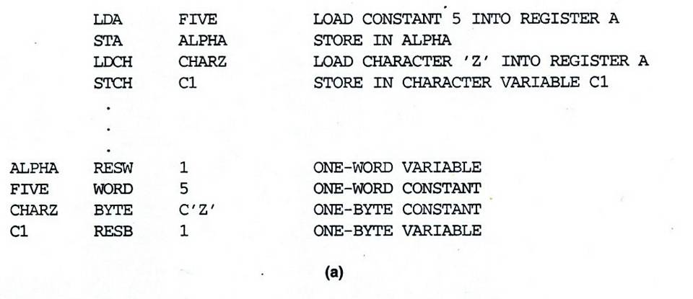
SIC Programming Examples (Fig 1.2a)
To store 5 in ALPHA and z in C1

Slide 46
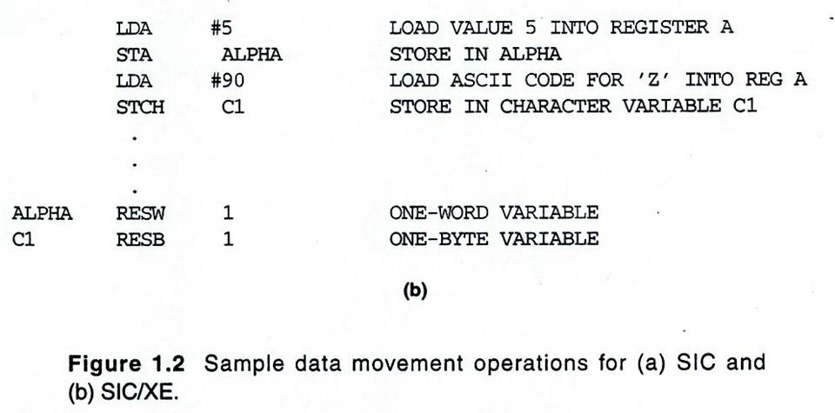
SIC/XE Programming Examples (Fig 1.2b)

Slide 47
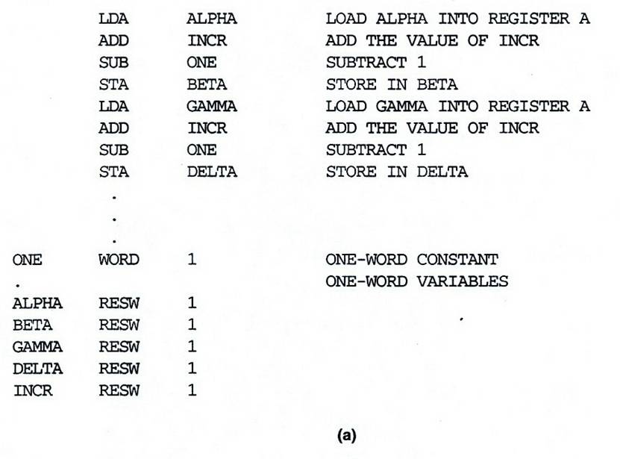
SIC Programming Example (Fig 1.3a)
BETA=ALPHA+INCR-1 AND DELTA=GAMMA+INCR-1

Slide 48
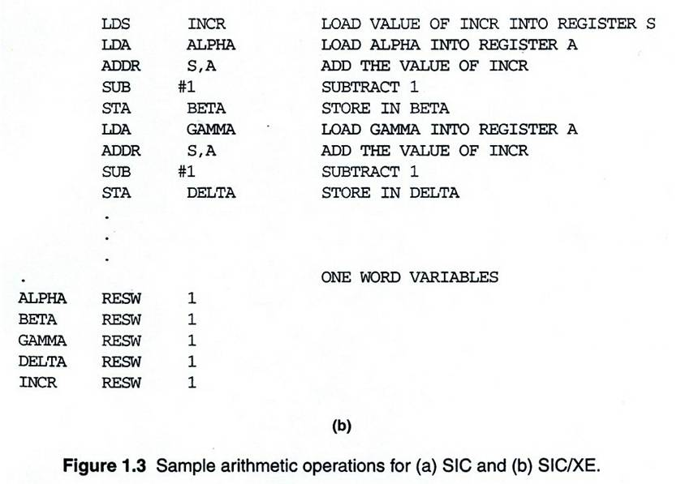
SIC/XE Programming Example (Fig 1.3b)

Slide 49
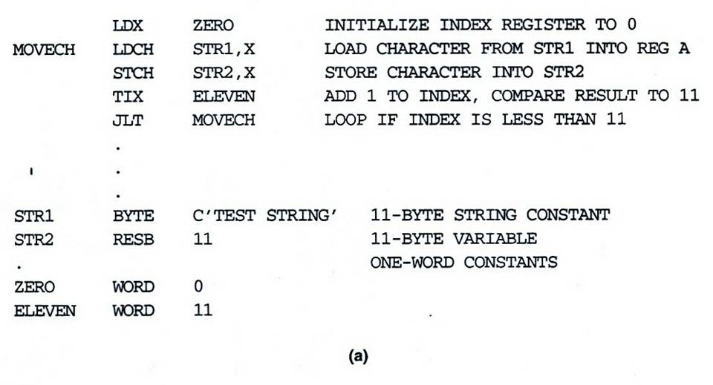
SIC Programming Example (Fig 1.4a)
to copy one 11 byte char string to another

Slide 50
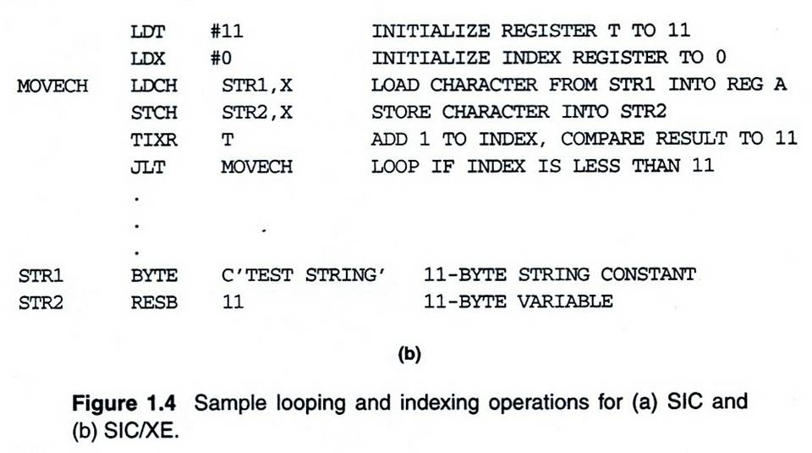
SIC/XE Programming Example (Fig 1.4b)

Slide 51
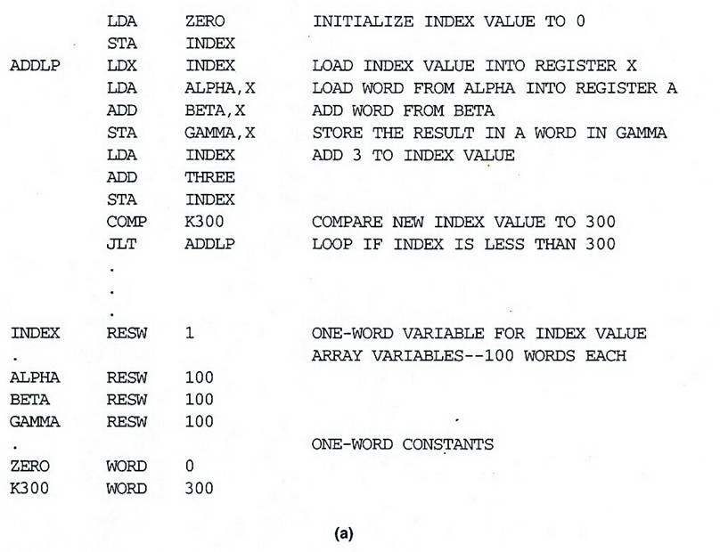
SIC Programming Example (Fig 1.5a)
GAMMA[I]=ALPHA[I]+BETA[I]
I=0 to 100

Slide 52
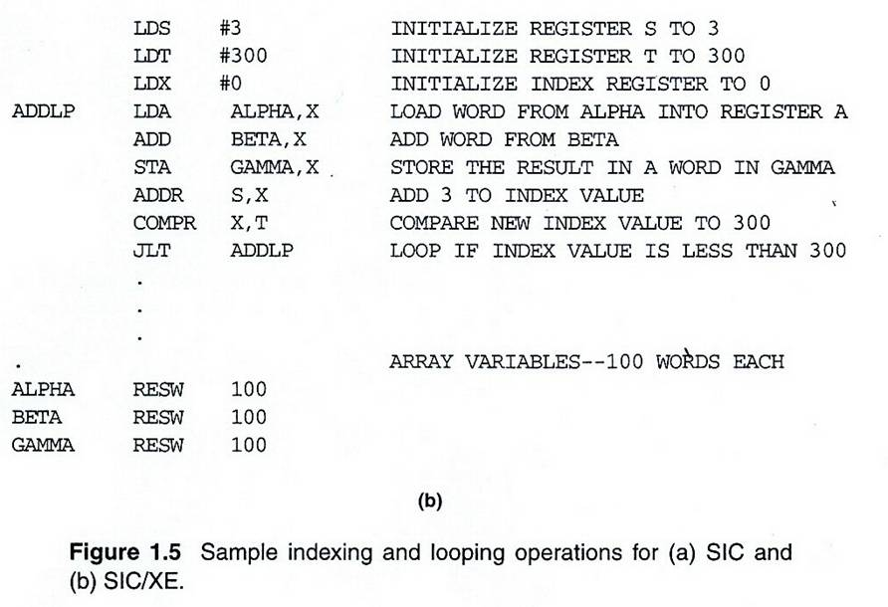
SIC/XE Programming Example (Fig 1.5b)

Slide 53
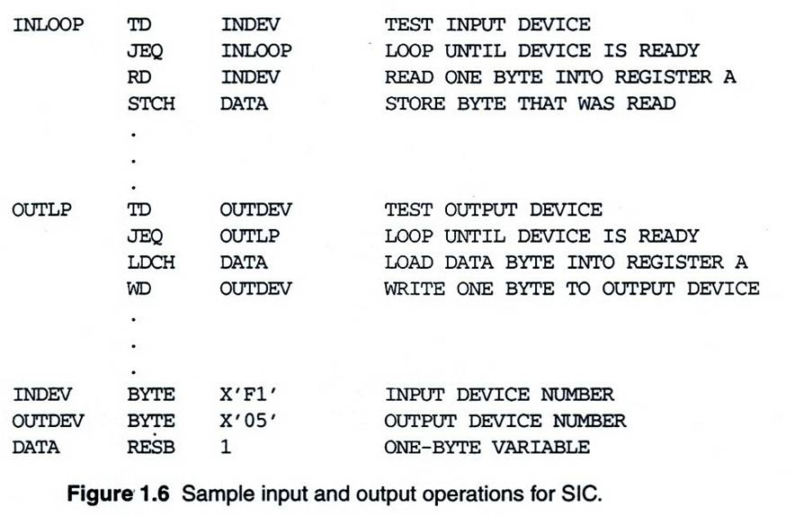
SIC Programming Example (Fig 1.6)
to read 1 byte of data from device F1 and copy it to device 05

Slide 54
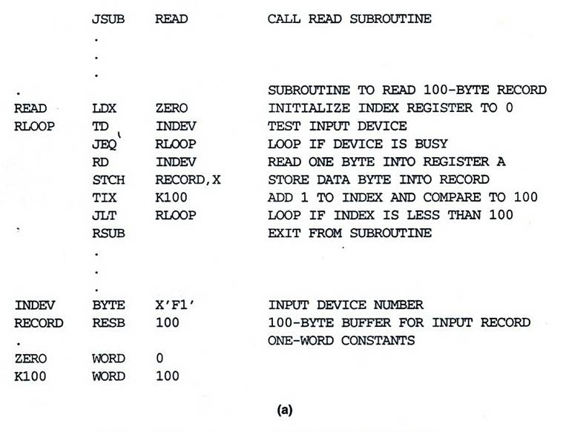
SIC Programming Example (Fig 1.7a)
To read 100 bytes of record from an input device into memory

Slide 55
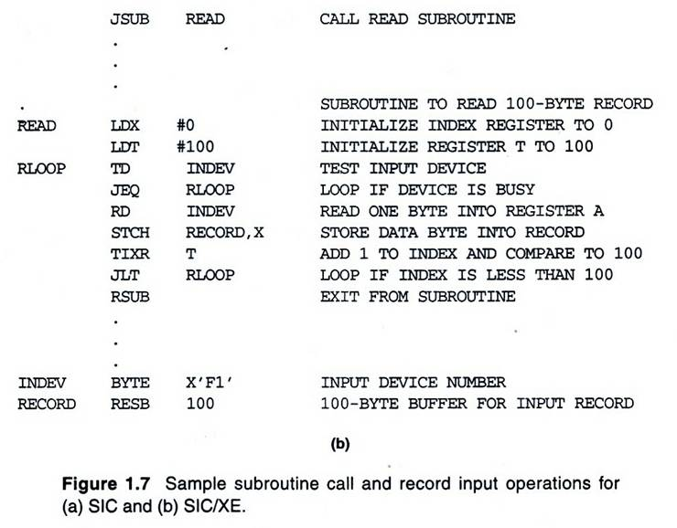
SIC/XE Programming Example (Fig 1.7b)

Slide 56
End of Chapter 01
Introduction to a Machine Architecture

